Slide 1
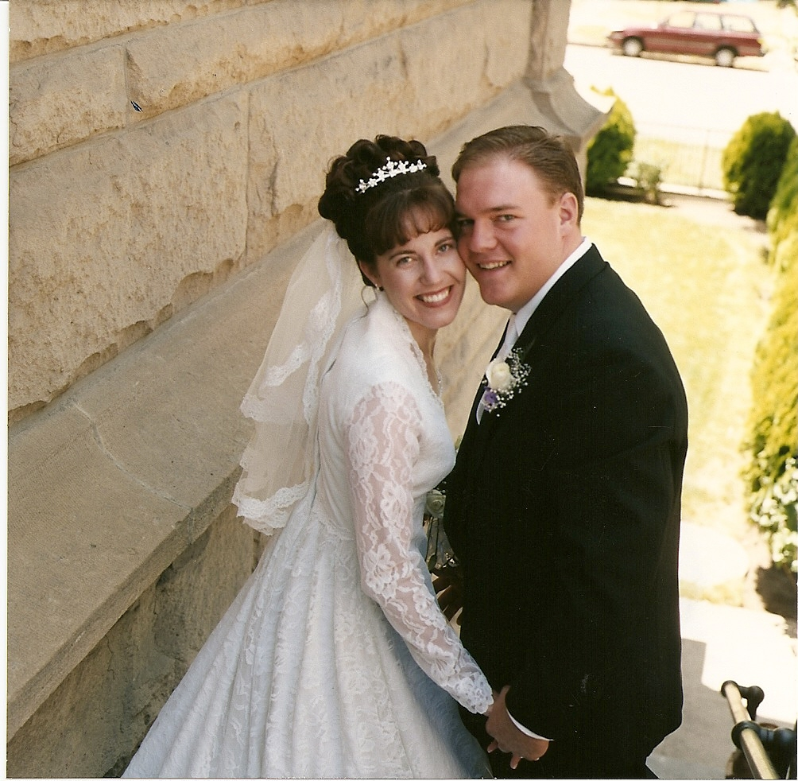
Jeff and Erika Cowman
Met when Jeff was 17 and Erika 18, on Bishop Kelly campusMarried at St. John’s Cathedral June 2003Became NFP Teachers 2009

Slide 2

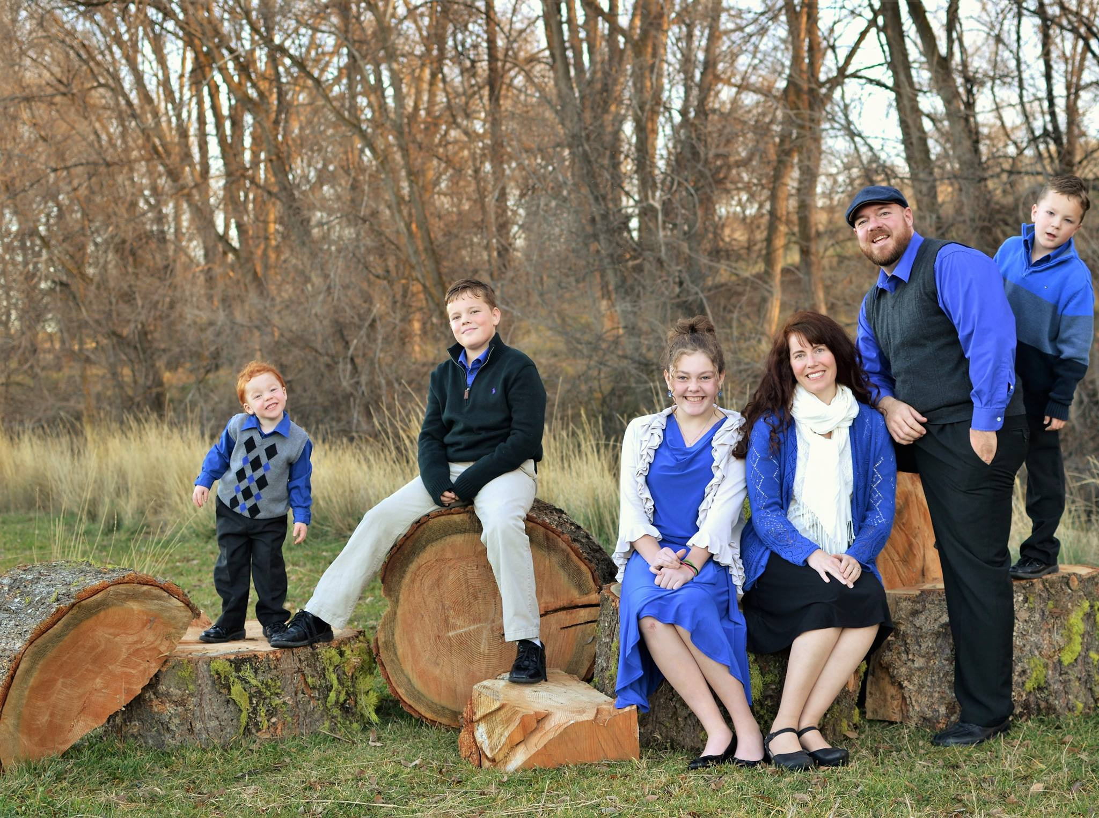
Children
Mikaela Joan 13Kaleb Alexander 11Baby George in heavenJohn Paul 7Gilbert Joseph 4

Slide 3
How we discovered NFP:
Grew up on dairy farmKnew about chastity, but not teaching on contraceptionOverheard parents joking about the Pope not liking vasectomiesVet science class in college—Animal reproduction—fertility is scienceAudio Talk: Professor Janet Smith—Contraception: Why Not?/Cracking the Myths
Erika

Slide 4
How we discovered NFP:
Learned about development and testing of the Pill in high school and how women diedMen fertile 24/7, Women a few days, seemed unjust to sterilize a womenLearned about NFP on a H.S. retreat Heard talks on Theology of the Body at Seminary and with ErikaCollege- completed a group project for statistics class on contraceptive use; I knew more about women’s cycles than my female classmates
Jeff

Slide 5
Our purpose here
Provide information on what NFP is & what it is notProvide facts / dispel mythsBenefits of NFPAnswer questions

Slide 6
Inform…not judge!
6

Slide 7

Fact or Myth?
Natural Family Planning (NFP) is an old fashioned method of trying to prevent pregnancy (Some call it the Rhythm method or Calendar method)

Slide 8
Myth!
Modern NFP is NOT the old Rhythm method our grandparents and great-grandparents used, but is based on scientifically studied signs of fertility

Slide 9

What is NFP?
Scientific knowledge of fertilityReading body’s signs of fertility and infertilityNatural Family Planning (NFP)Fertility Awareness Method (FAM)
9

Slide 10
Hormones in men
10

Slide 11
Hormones in women
11

Slide 12
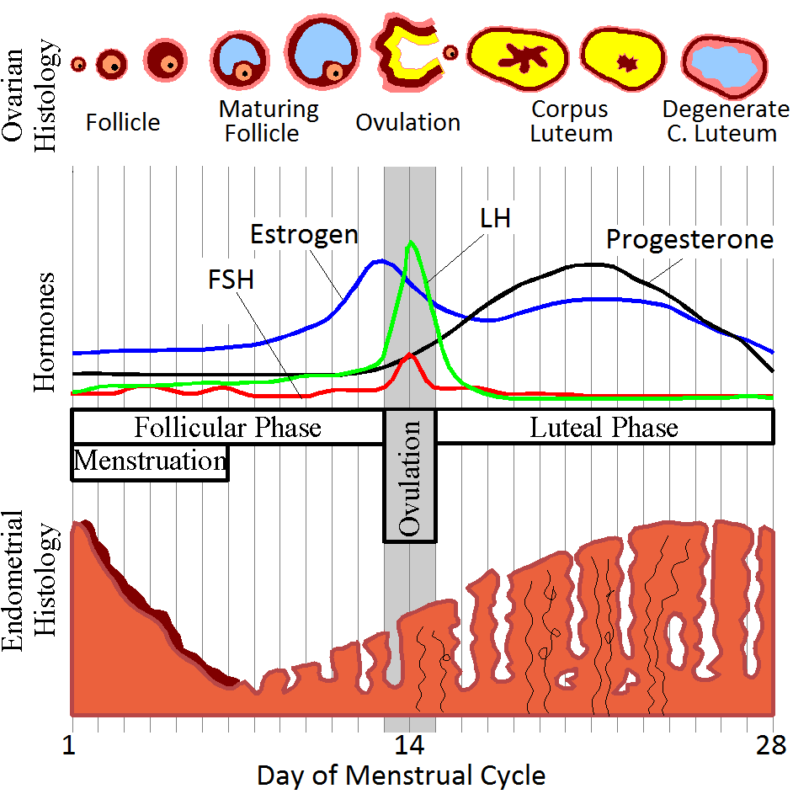
Putting it all together
I trust God’s design; He makes no mistakes; all of nature is cyclicalFertility=Health
This image is freely available at commons.wikimedia.org/wiki/ File:MenstrualCycle.png under a creative commons cc-by-sa 3.0 license

Slide 13
How NFP Works
Measures changes in signs of fertilityRecorded on chart to define fertility and infertility Abstain or have relations based on absence or presence of fertile signs

Slide 14
Sample CCL Chart
Sympto- thermal
How we chart

Slide 15
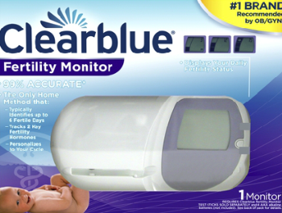
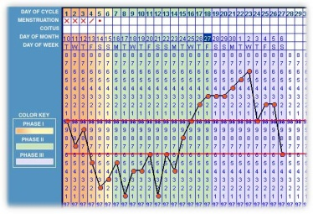
“There’s an app for that”
Fertility monitorsSoftwareMobile appsApps = virtual reality trainingClasses = real life trial and error application and instruction
“User Beware”

Slide 16
Fact or Myth?
Couples who use NFP have sex as often as couples who use contraception – they just time it differently.

Slide 17
Fact!
REALITY: If couples who practice NFP were to engage in intercourse on all the days when abstinence is not required for spacing births, they would be doing so at a rate almost twice the national average! NFP couples can make love no less frequently in each cycle than other couples.Abstinence is a part of marriageillnessWork travelMilitary deploymentBirthNo one has died from NOT having sex

Slide 18
NFP Benefit #1
Authentic Love…selfless, not selfish

Slide 19
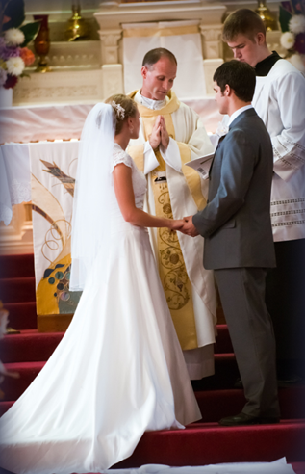
Marital love is a self-gift
100%-100%, Not 50/50Free, total, faithful, fruitfulCommitment at altar“Have you come here freely to give yourselves to each other without reservation?”“Do you promise to be faithful until death?”“Do you promise to receive children lovingly from God?”

Slide 20
Every Sacrament—form & matter
Baptism=form: baptize you in the name of the Father,…..matter: water Eucharist=Form: words of the last supperMatter: bread and wineMarriage=Form: vows made by the coupleMatter: consummation of the marriage (to complete a marriage by the first act of sexual intercourse)

Slide 21

Sexual Intercourse=Renewing Wedding Vows
Now chastity made sense—we can’t renew vows we haven’t madeIn our vows we promise to love: Freely, Totally, Faithfully, FruitfullyWith NFP we are free to give our complete selves the way God made us, just as we are, without altering ourselves—fertility is not an illness

Slide 22
© Couple to Couple League International

Slide 23
Fact or Myth?
Couples who practice NFP have a less than 5% divorce rate.

Slide 24
Fact!
Studies of shown that couples who practice Natural Family Planning have a divorce rate between 1-5%Couples who pray together daily (not meal prayer) have a divorce rate of .01%

Slide 25
NFP Benefit #2
Stronger Marriage & Greater Intimacy

Slide 26
Why increased intimacy?
Stronger relationships may be more likely to practice NFPCouples who reject NFP as “too much trouble” or “too restrictive” all too often turn out to be the same couples who ultimately find the demands of marriage itself to be too much to handle ~Jason EvertNFP takes virtue—so does marriagecommitment, communication, consideration, patience, sacrifice and self-control; These are what makes marriage work.NFP requires communicationShared responsibility; chart togetherKeeps spouses from taking each other for granted and relying on physical intimacyMany women on contraception complain of feeling used. Contraception can lead the husband to assume that she was always sexually available. With NFP, Spouses are not constantly sexually available to the other Couples we know personally report that their physical life is better

Slide 27
Chastity Tests Love
Immature views of love and relationship will rise to the surface when chastity is requiredAbstinence is a built in a time when they can “court”; every kiss does not need to lead to the bedroomHelps us focus on intellectual, emotional, spiritual intimacy

Slide 28
Fact or Myth?
The Catholic Church calls married couples to have as many children as possible.

Slide 29
Myth!
REALITY: The Catholic Church encourages people to be both generous and responsible stewards over their fertility.

Slide 30
NFP Benefit #3
Countercultural—Children viewed as a gift, not a burden

Slide 31
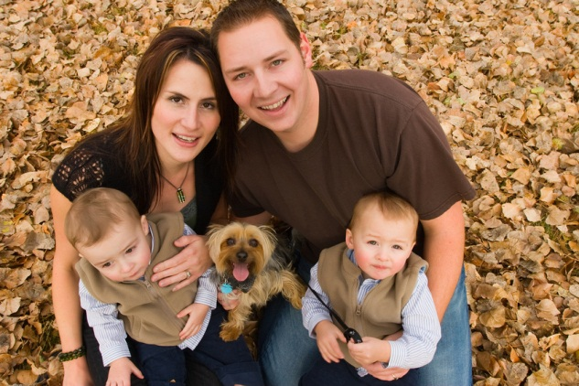
Marital Embrace
Babies & Bonding“So they are no longer two, but one flesh. Therefore what God has joined together, let no one separate.” ~Matthew 19:6

Slide 32
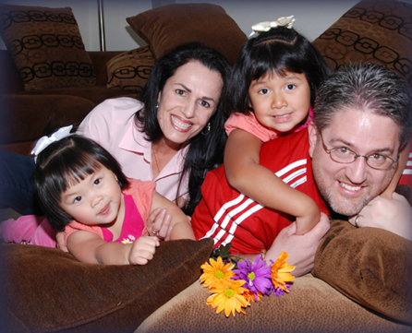
But what about those huge families?
All Christians are called to generosityNowhere in the Bible are children a curse or burden; they are ALWAYS a blessing; Couples who reject contraception are less likely to see children as a burden. Because of their generous spirit, they tend to have larger families, and divorce rates are highest where children are fewest.

Slide 33
Inviting God Into the Marriage
Monthly discernment of what God is calling that family to beHow’s our marriage?How is our family doing?Are we being generous? Prudent?Lord help us overcome…Lord, help us to trust…Not telling God our plan, but asking HimWedding invitation analogy (from Christopher West)

Slide 34
Fact or Myth?
Only women with regular cycles can use NFP.

Slide 35
Myth!
Reality: NFP can be used by women with irregular cycles, and can even help detect, diagnose and treat health problems, including infertility.

Slide 36
NFP Benefit #4
Safe, Healthy, and a Diagnostic Tool

Slide 37

If Sex is natural, why do we make it artificial?

Slide 38
How the pill and IUD work
Progestin convinces woman’s body she’s pregnantSuppress ovulationBack-up method thin uterine lining to prevent implantation (abortifacient)Breakthrough ovulation common
Larimore W, Stanford J, Postfertilization Effects of Oral Contraceptives and Their Relationship to Informed Consent, Arch Fam Med (2000);9:126-133.

Slide 39
Adverse Effects
Increased Risk of Breast Cancer (and other cancers)Post contraceptive infertilityDecrease libido (artificial hormones increase Sex Hormone Binding Globulin, decrease testosterone levels, sometimes permanent damage)Decreased bone densityIncreased depressionDepo Provers (the shot): CA administers it to sex offenders; veterinarians won’t give it to dogsIf mom conceives on the Pill, sons are more likely to develop prostate cancerSpeaking of Pure water…Damage to the environment

Slide 40

“Gallup poll”
Of the women in the US who discontinued hormonal contraceptives, how many did so because of side effects?33%43%53%64%
National Survey of Family Growth 2010, CDC, Series 23, Number 29, 69.

Slide 41
Diagnostic Tool
Charting fertility signs can help discover or diagnose health issues such as:Low thyroidLow progesteroneRepeated miscarriageInfertilityDepressionPolycystic Ovarian Syndrome

Slide 42
Fact or Myth?
Natural Family Planning is just as effective at limiting births as artificial means.

Slide 43
Fact!
Modern scientific NFP is 99% effective at limiting birth when couples are motivated to follow the rules (80-90% effective when they don’t even follow the rules)3 Xs more successful than modern technology in helping couples of limited fertility achieve pregnancy

Slide 44
NFP Benefit #5

Slide 45
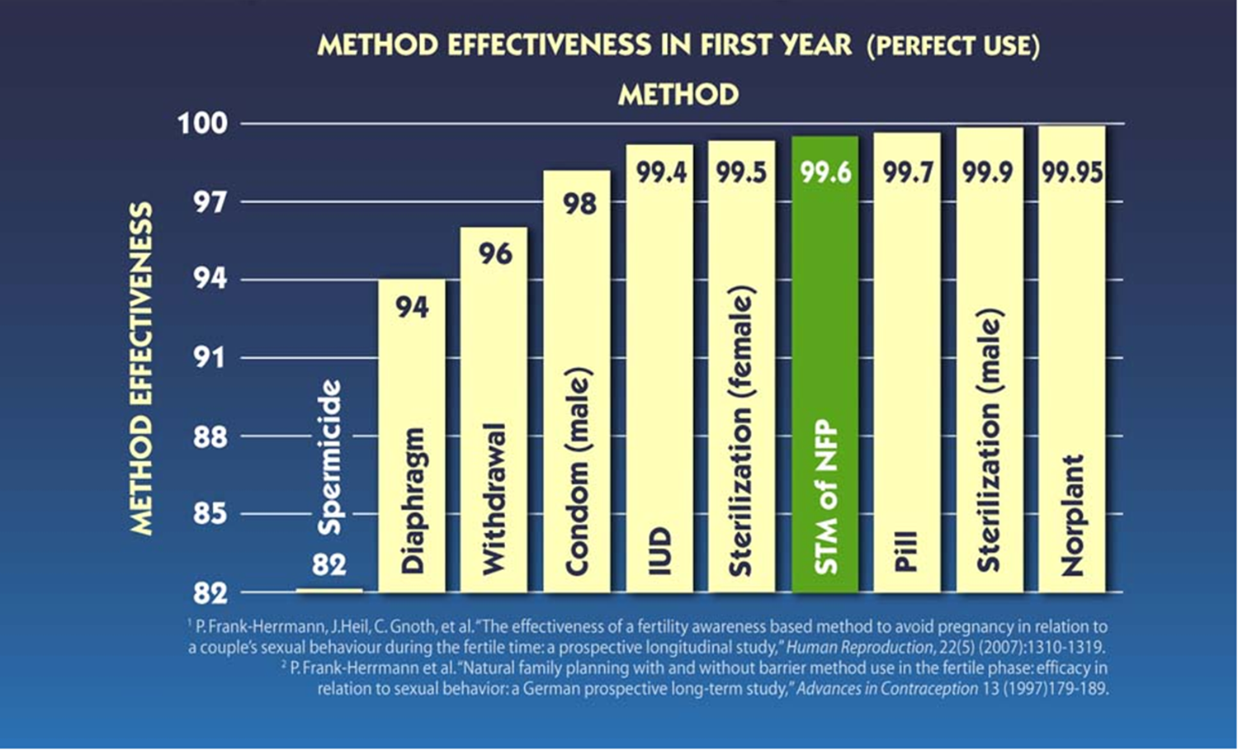

Slide 46
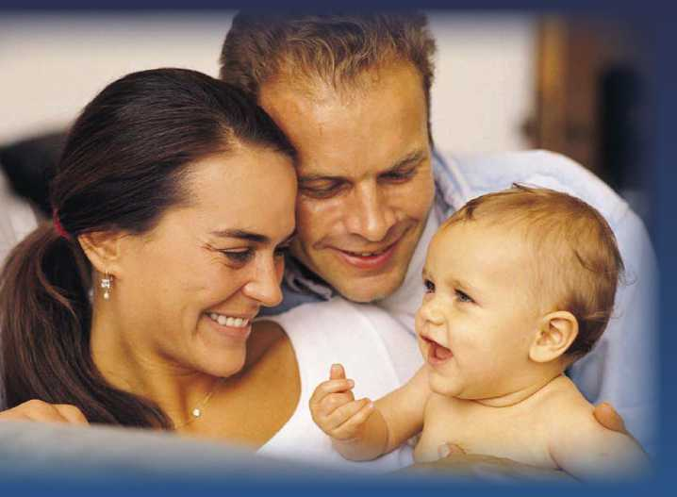
NFP to achieve a pregnancy
10-15% of couples suffer from infertility (more than 1 year of trying to conceiveFertility awareness can help couples conceive in half the time or lessKnowing how to identify the fertile window is key

Slide 47
“A relatively high failure rate has been reported.” The “failure rate” WebMD cites combined data from modern NFP methods with data from calendar methods artificially lowering the effectiveness of NFP

Slide 48
But isn’t it too complicated and unrealistic?
In a World Health Organization (WHO) study, 725 couples from five countries – El Salvador, India, New Zealand, Ireland, and the Philippines – were taught the ovulation method of NFP over the course of three months. After a year the couples were evaluated, and the method effectiveness rate was 97.2%. Note: half of the Salvadorean couples were illiterate, proving that an advanced education is unnecessary for learning NFP effectivelyBritish medical journal report: study of 19,000 women in India (52% Hindu, 27% Muslim, and 21% Christian)—failure rate of almost 0% ( 0.2 pregnancies/100 women). Thanks to Mother Teresa, couples avoided government mandated sterilization in the 70s; today India still has sterilization quotas, leading to many deaths from botched operations From a publication of the Missionaries of Charity “Many people wonder how poor couples can exercise self-control for more than one week. Yes, they do it; it is possible. It is, after all, their own choice. Some abstain for twenty days a month; others for one, two, and even three months. From our experience we find that it is more difficult for an educated couple to abstain than for a poor and illiterate couple. Why? Perhaps because the wealthy and educated couples have more comforts, and are more inclined to enjoy the good things of life.”

Slide 49
Isn’t NFP just “natural” birth control
NFP is birth control; it is not contra-ception (against life).Yes, a couple using NFP could be closed to God’s will; they could use it selfishly—but rareOne is a lack of generosity; the other is using the body and making a loving act intentionally sterile, potentially aborting a new life, and separating what God designedTwo women wishing to stay slim analogy

Slide 50

Web resourcesfertilitycare.orgChastity.compopepaulvi.comccli.orgboma-usa.orgnfp.marquette.edunfpandmore.orgonemoresoul.comnwfs.orghttp://nfpsst.org/fact-or-fiction/usccb.org/issues-and-action/marriage-and-family/

